Slide 1
WHO’S THAT IN THE HAT?
A Guide to rank, regalia, and awards in the sca
Baroness Margaret Lad, OP
Kingdom Chatelain, Kingdom of Atlantia
—
All photographs courtesy of Master Ursus unless otherwise noted.
https://www.bogpages.com/SCA-photographs

Slide 2
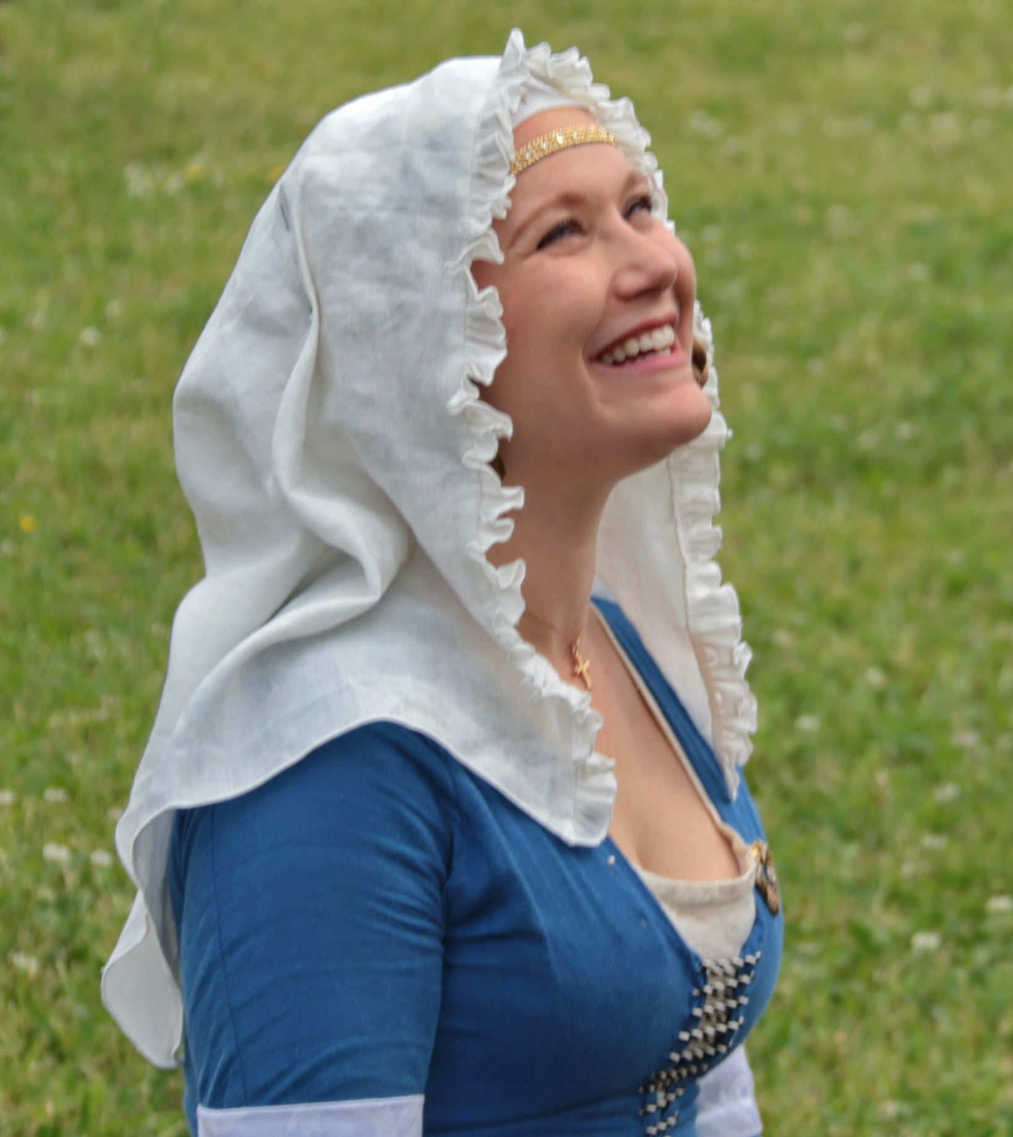
Introductions
Baroness Margaret Lad, OP MKA Megan Ladd.
Started in the SCA in 2013 in the Barony of Storvik (mundanely known as Washington D.C.) in the Kingdom of Atlantia but is now living in the Shire of Isenfir (Charlottesville, VA area).
Have been a Chatelain (Officer responsible for the recruitment and retention of members) since 2015.
14th century English persona.
Favorite activities in the SCA are archery, embroidery, and socializing.
https://ladymargaret.blog/

Slide 3
Agenda
Royals
Baronage
Overview of Awards
Armigerous and Non-Armigerous Society Awards
Kingdom Awards (Specific to the Kingdom of Atlantia)
Baronies of Atlantia
  Baronial Awards
Notes
Contact

Slide 4
Before we get started…
https://www.sca.org/
http://atlantia.sca.org/
https://tasha.gallowglass.org/sca/sumptuary.html

Slide 5
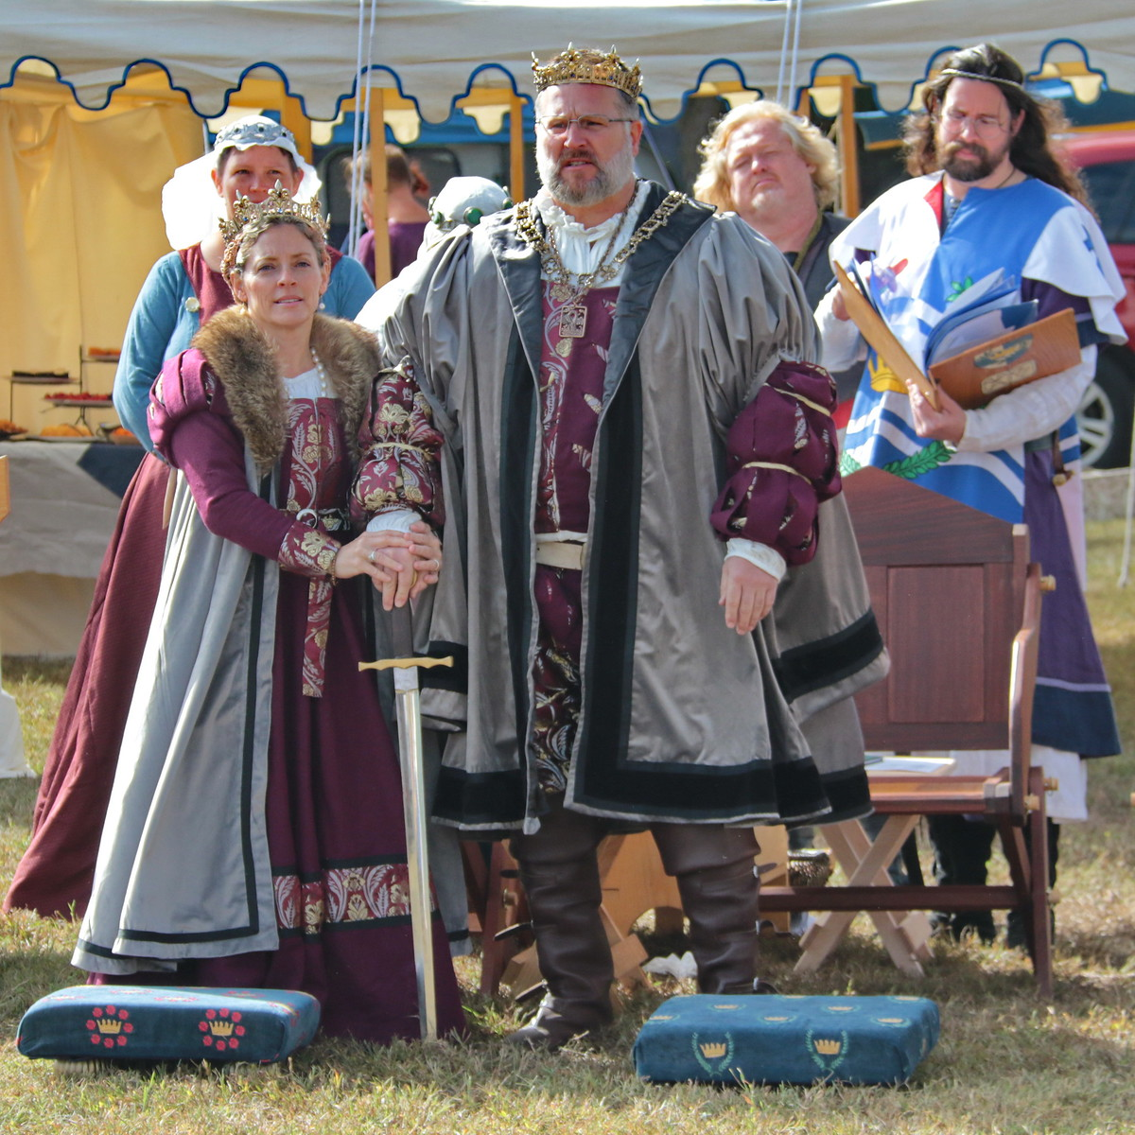
royals
The Crown/Monarchs/Royals are considered absolute rulers within our medieval world.
The correct way to address the Crown of a Kingdom is with “Your Majesty”.
The correct way to address the Heirs to the Crown of a Kingdom is with “Your Highness”.
The correct way to address the Crown of a Principality is with “Your Highness”.
They often wear the heraldry of the Kingdom or Principality that they represent. They also wear the crowns of that Kingdom or Principality.
To view pictures of the Crowns worn in different Kingdoms, check out this great website: http://www.goldenstag.net/MiscSCA/CrownsAndCoronets.htm

Slide 6
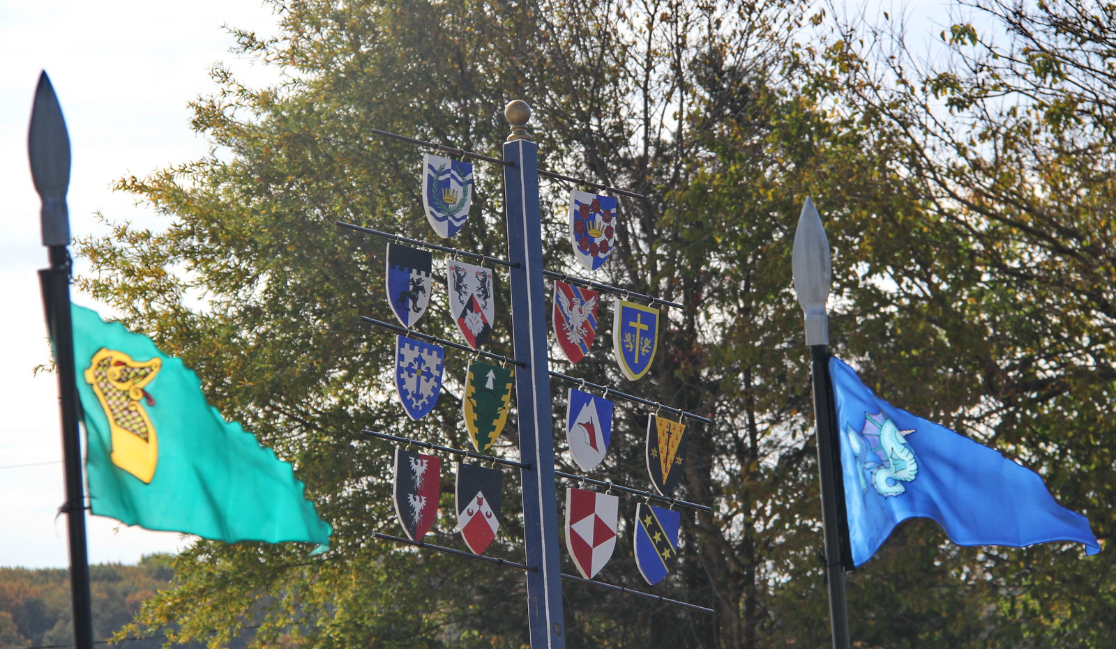
Crown tournament
  In order to become Royalty, fighters will apply by letter of intent in order to compete in a Crown Tournament.
  The winner of that tournament and their consort are named Heirs, to be Crown at the next Coronation.
  The length of a Crown’s reign is either four or six-months following a prior term as Crown Heirs.

Slide 7
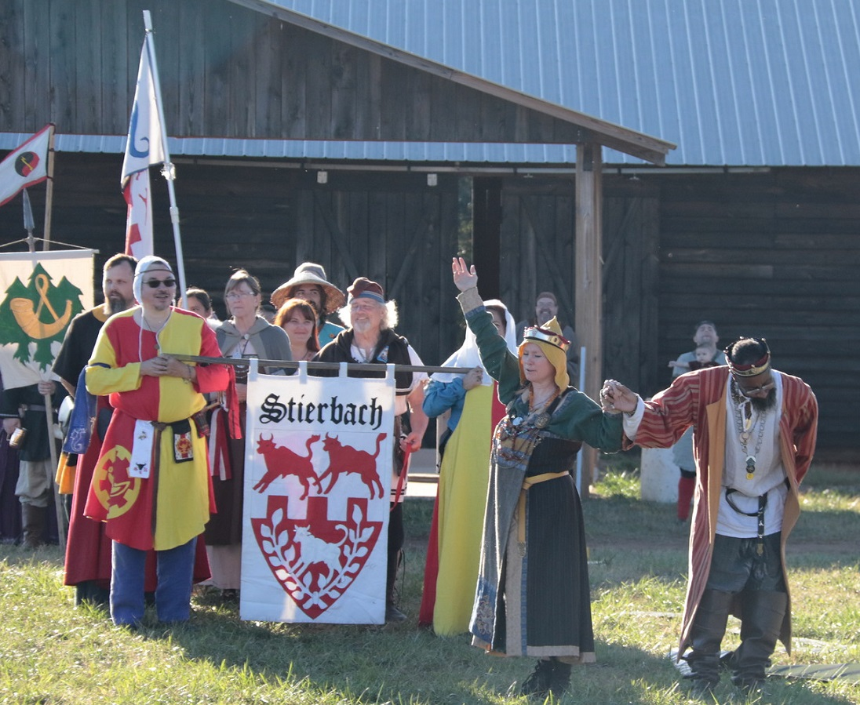
Landed baronage
A Landed Baron/Baroness (also called a Territorial Baron/Baroness) oversees a Barony, which is one type of regional group inside of a kingdom.
The Baronage serve as representatives to the Crown.
In Atlantia, our Baronage have an original term of 3 years and can choose to continue for another 2 years.
Landed Baronage are chosen by the Crown following a polling of the opinions of the populace.
Baronial Coronets have six points and often use elements of Baronial Heraldry on them so people can identify them.
Landed Baronage answer to the title “Your Excellency”.

Slide 8
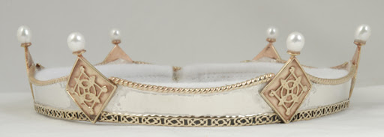
Court baronage
Court Barons/Baronesses are people who have been awarded that title by the Crown.
In Atlantia, a Landed Baron/Baroness is traditionally awarded this title as a reward for their service as Baronage once that service is complete.
Other people can be made a Court Baron or Baroness as a “thank you” for dedicated service or great skill or simply at the whim of the Crown.
Baronial Coronets have six points and often use elements of an individual’s heraldry.
Court Baronage answers to the title “Your Excellency”.
Image courtesy of http://www.sunshadowdesign.com/coronets/

Slide 9
Awards
Patent of Arms Level (Peerages)
Non-Armigerous Society Awards
Grants of Arms Level (including Orders of High Merit)
Awards of Arms Level (including Orders of Merit)
Non-Armigerous Kingdom Orders and Awards
Baronial Orders and Awards

Slide 10
Armigerous society awards

Slide 11

Royal peers
A Count or Countess is someone who has reigned as Royalty once.
They are addressed as “Your Excellency”.
A Viscount or Viscountess is someone who has reigned as Prince/Princess of a Principality at least once.
They are addressed as “Your Excellency”.
A Duke or Duchess is someone who has reigned as Royalty at least twice.
They are addressed as “Your Grace”.

Slide 12
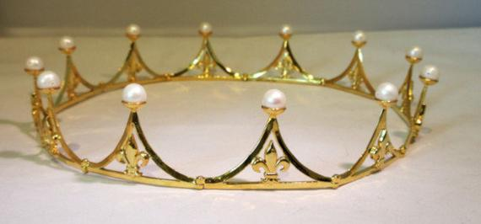
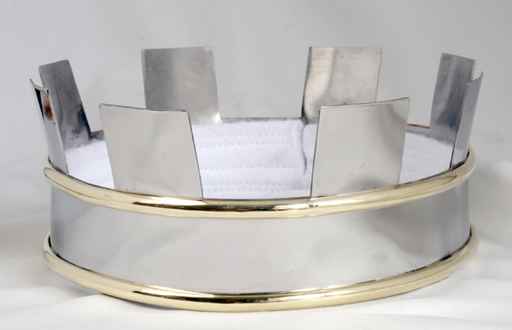
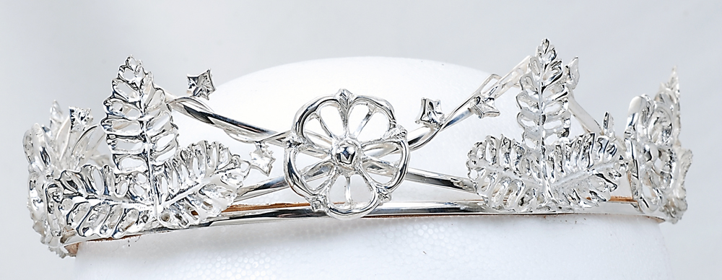
Coronets
Examples of a Viscounty, County, and Ducal Coronet are pictured here.
Images courtesy of: http://www.sunshadowdesign.com/coronets and https://www.etsy.com/shop/MadJeweler

Slide 13
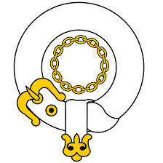
Chivalry
The Order of the Chivalry is composed of individuals who have been recognized for their excellence in the skills of armored combat.
If upon induction into the Order the individual chooses to swear fealty to the Crown, they are made a Knight. If they choose not to do so, they are made a Master or Mistress of Arms.
Knights are referred to and addressed by the title of Sir, and they have the right to wear a white belt, spurs, and a chain of fealty.
Masters and Mistresses of Arms are referred to and addressed by the title of Master/Mistress, and they have the right to wear a white baldric and spurs.
Students of the Chivalry are known as Squires and typically wear a red belt.

Slide 14

Laurel
The Order of the Laurel is composed of individuals who have been recognized for their excellence in and dedication to the Arts & Sciences.
Companions of the Order of the Laurel are typically addressed by the title of Master/Mistress.
Only a Laurel has the right to wear the badge of the Order - a laurel wreath.
Students of Laurels are known as Apprentices and typically wear a green belt.

Slide 15
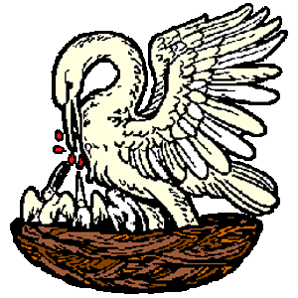
Pelican
The Order of the Pelican is composed of individuals who have been recognized for their excellence in, and dedication, to service.
Companions of the Order of the Pelican are typically addressed by the title of Master/Mistress.
Only a Pelican has the right to wear the badge of the Order - a pelican in its piety.
Students of Pelicans are known as Proteges and typically wear a yellow belt.

Slide 16
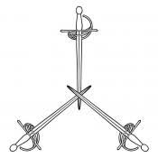
Master of Defense (MoD)
The Order of Defense is composed of individuals who have been recognized for martial prowess on the rapier and/or cut-and-thrust field.
Companions of the Order of Defense are typically addressed by the title of Master/Mistress.
Only a Master of Defense has the right to wear the badge of the Order - three rapiers in pall inverted tips crossed.
A MoD will typically wear a white collar.
The title for a student of a Master of Defense will vary depending on the Kingdom.

Slide 17
Non-Armigerous Society Awards
Supporters
Supporters are figures usually placed on either side of the shield and depicted holding it up. These figures may be real or imaginary animals, human figures, and in rare cases plants or inanimate objects.
Augmentation of Arms
An honor added to a registered device. The Crown of a Kingdom must give the recipient the right to add a charge or charges. The recipient then decides on the desired form of the augmentation, though the Crown may make suggestions including the kingdom's standard augmentation (if one is registered).

Slide 18
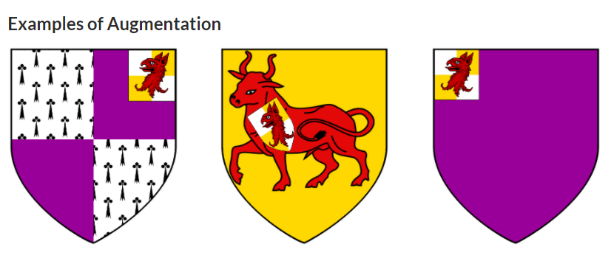
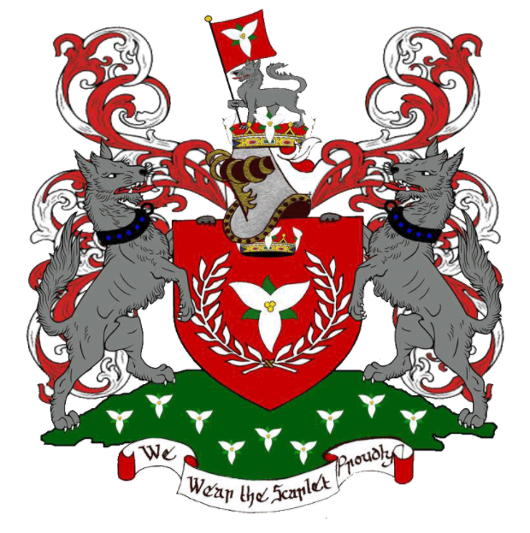
Supporters & Augmentations of Arms
Source: http://heraldry.avacal.org/
For more information on heraldry: https://heraldry.sca.org/
Source: http://www-cs.canisius.edu/~salley/SCA/Articles/achievement.html

Slide 19
Armigerous Kingdom Awards
Specific to the Kingdom of Atlantia: http://op.atlantia.sca.org/

Slide 20
Awards of Arms Level (including Orders of Merit)
Award of Arms
Court Barony
Order of the Silver Osprey
Order of the Sea Dragon
Order of the King’s Missiliers
Order of the Coral Branch
Order of the Opal
Order of the Quintain
Specific to the Kingdom of Atlantia: http://op.atlantia.sca.org/

Slide 21
Grants of Arms Level (including Orders of High Merit)
Grant of Arms
Order of the White Scarf
Order of the Sea Stag
Order of the Kraken
Order of the Yew Bow
Order of the Pearl
Order of the Golden Dolphin
Order of the Golden Lance
Specific to the Kingdom of Atlantia: http://op.atlantia.sca.org/

Slide 22
Non-Armigerous Kingdom Orders
Order of the Rose
Queen’s Order of Courtesy
Order of the Nonpareil
Specific to the Kingdom of Atlantia: http://op.atlantia.sca.org/

Slide 23
Non-Armigerous Kingdom Awards
Shark’s Tooth
Silver Nautilus
Fountain
King’s Award of Excellence
Undine
Herring
Vexillum Atlantiae
Star of the Sea
Specific to the Kingdom of Atlantia: http://op.atlantia.sca.org/

Slide 24
Youth Awards
Sea Urchin
Arielle
Royal Augmentation of Arms
Hippocampus
Sea Tyger
Alcyon
Specific to the Kingdom of Atlantia: http://op.atlantia.sca.org/

Slide 25
Baronies & Baronial Awards

Slide 26
Baronies
Windmaster’s
Hill
Caer Mear
Storvik
Nottinghill Coill
Tir-y-Don
Sacred Stone
Black DIamond
Hidden Mountain
Marinus
Lochmere
Ponte Alto
Dun Carraig
Bright Hills
Stierbach
Highland Foorde
Hawkwood
Raven’s
Cove
In addition to Baronies, the Kingdom of Atlantia also has Shires and Cantons.
However, only Baronies may give awards to their populace.

Slide 27

Baronial Awards
There are 17 Baronies within the Kingdom of Atlantia, each with their own specific awards.
To view the Baronies and the awards, please visit the Atlantian Order of Precedence: http://op.atlantia.sca.org/baronies.php

Slide 28
Notes
Anyone can recommend a person for an award. If you notice someone working hard or excelling in a particular area you can recommend them by using the recommendation system at: https://award.atlantia.sca.org/
If you do not know what awards someone has, you can find out by looking at the Order of Precedence on the Atlantia web site: http://op.atlantia.sca.org/

Slide 29
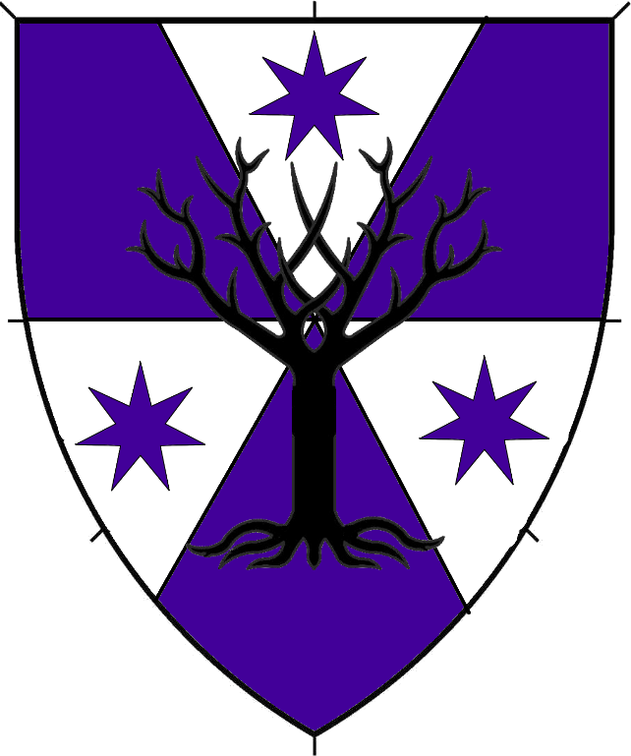
Contact
Baroness Margaret Lad, OP
MKA Megan Ladd
Add me on Facebook!
Email: chatelain@atlantia.sca.org
Website: https://ladymargaret.blog/

